Slide 1

Managing and Using Information Systems: A Strategic Approach – Sixth Edition
Keri Pearlson, Carol Saunders, and Dennis Galletta
© Copyright 2016 John Wiley & Sons, Inc.

Slide 2
Chapter 7 Security

Slide 3
Opening Case
What are some important lessons from the opening case?
How long did the theft take? How did the theft likely occur?
How long did it take Office of Personnel Management (OPM) to detect the theft?
How damaging are the early reports of the data theft for the OPM?
World’s Biggest Breaches and Hacks
Notes:
The hackers did not carry out a dramatic and quick theft; they had a year to steal the records at their leisure.
The theft took place over a year, and the hackers stole a password.
It took many months for OPM to detect the theft.
Early reports say that at least 4 million, and as many as 14 million records were stolen. Each record contained 127-page security clearances that include sensitive medical, personal, and relationship information.

Slide 4
How Long Does it Take?
How long do you think it usually takes for someone to discover a security compromise in a system after the evidence shows up?
Several seconds
Several minutes
Several hours
Several days
Several months
A Mandiant study revealed that the median for 2014 was 205 days! That’s almost 7 months!
The record is 2,982 which is 11 years!

Slide 5
Timeline of a Breach - Fantasy
Hollywood has a fairly consistent script:
0: Crooks get password and locate the file
Minute 1: Crooks start downloading data and destroying the original
Minute 2: Officials sense the breach
Minute 3: Officials try to block the breach
Minute 4: Crooks’ download completes
Minute 5: Officials lose all data
Source: http://www.verizonbusiness.com/resources/reports/rp_2010-DBIR-combined-reports_en_xg.pdf

Slide 6
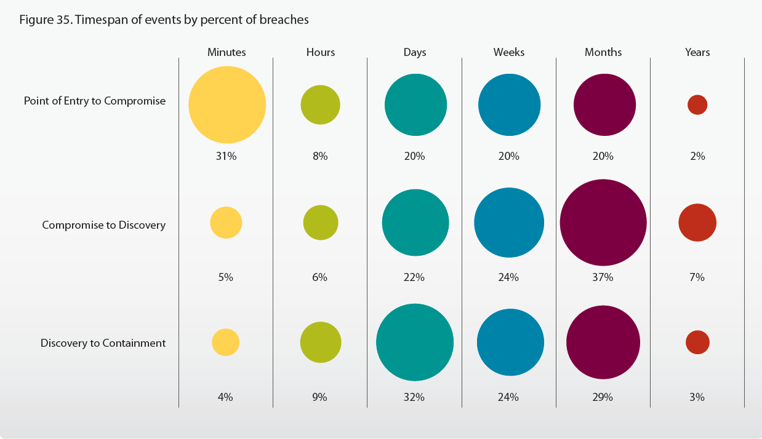
Timeline of a Breach - Reality
Source: http://www.verizonbusiness.com/resources/reports/rp_2010-DBIR-combined-reports_en_xg.pdf

Slide 7
IT Security Decision Framework
Decision | Who is Responsible | Why? | Otherwise?
Information Security Strategy | Business Leaders | They know business strategies | Security is an afterthought and patched on
Information Security Infrastructure | IT Leaders | Technical knowledge is needed | Incorrect infrastructure decisions
Information Security Policy | Shared: IT and Business Leaders | Trade-offs need to be handled correctly | Unenforceable policies that don’t fit the IT and the users
SETA (training) | Shared: IT and Business Leaders | Business buy-in and technical correctness | Insufficient training; errors
Information Security Investments | Shared: IT and Business Leaders | Evaluation of business goals and technical requirements | Over- or under-investment in security

Slide 8
How Have Big Breaches Occurred?
Date Detected | Company | What was stolen | How
November 2013 | Target | 40 million credit & debit cards | Contractor opened virus-laden email attachment
May 2014 | Ebay #1 | 145 million user names, physical addresses, phones, birthdays, encrypted passwords | Employee’s password obtained
September 2014 | Ebay #2 | Small but unknown | Cross-site scripting
September 2014 | Home Depot | 56 million credit card numbers 53 million email addresses | Obtaining a vendor’s password/exploiting OS vulnerability
January 2015 | Anthem Blue Cross | 80 million names, birthdays, emails, Social security numbers, addresses, and employment data | Obtaining passwords from 5 or more high-level employees

Slide 9
Password Breaches
80% of breaches are caused by stealing a password.
You can steal a password by:
Phishing attack
Key logger (hardware or software)
Guessing weak passwords (123456 is most common)
Evil twin wifi

Slide 10
Insecurity of WiFi– a Dutch study
“We took a hacker to a café and, in 20 minutes, he knew where everyone else was born, what schools they attended, and the last five things they googled.”
Had WiFi transmitter broadcasting “Starbucks” as ID
Because they were connected to him, he scanned for unpatched or vulnerable mobile devices or laptops
He also saw passwords and could lock them out of their own accounts.
The correspondent: “I will never again be connecting to an insecure public WiFi network without taking security measures.”

Slide 11
Other Approaches
Cross-site scripting (malicious code pointing to a link requiring log-in at an imposter site)
Third parties
Target’s HVAC system was connected to main systems
Contractors had access
Hackers gained contractors’ password
Malware captured customer credit card info before it could be encrypted

Slide 12
Cost of Breaches
Estimated at $145 to $154 per stolen record
Revenue lost when sales decline
Some costs can be recouped by insurance

Slide 13
Can You be Safe?
No, unless the information is permanently inaccessible
“You cannot make a computer secure” – from Dain Gary, former CERT chief
97% of all firms have been breached
Sometimes security makes systems less usable

Slide 14
What Motivates the Hackers?
Sell stolen credit card numbers for up to $50 each
2 million Target card numbers were sold for $20 each on average
Street gang members can usually get $400 out of a card
Some “kits” (card number plus SSN plus medical information) sell for up to $1,000
They allow opening new account cards
Stolen cards can be sold for bitcoin on the Deep Web

Slide 15
What Should Management Do?
Security strategy
Infrastructure
Access tools *
Storage and transmission tools *
Security policies *
Training *
Investments
* Described next

Slide 16
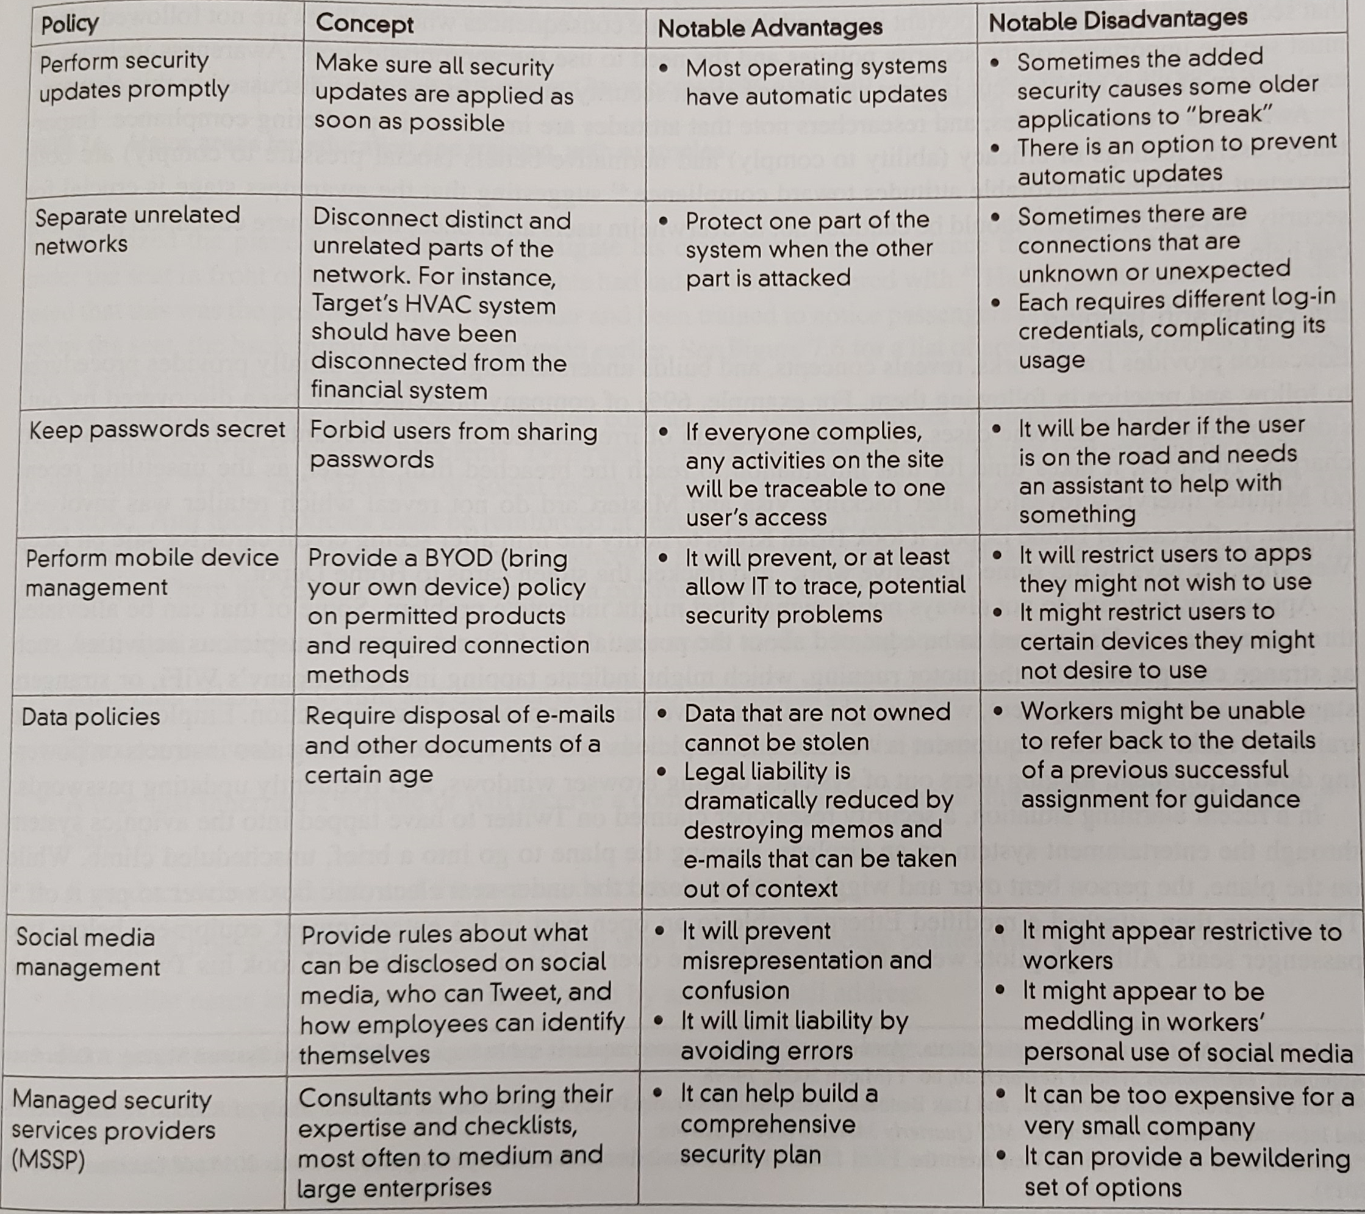
Commonly used management security policies

Slide 17
Access Tools
Access Tool | Ubiquity | Advantages | Disadvantages
Physical locks | Very high | Excellent if guarded | Locks can be picked Physical Access is often not needed Keys can be lost
Passwords | Very high | User acceptance and familiarity Ease of use Mature practices | Poor by themselves Sometimes forgotten Sometimes stolen from users using deception or key loggers
Biometrics | Medium | Can be reliable Never forgotten Cannot be stolen Can be inexpensive | False positives/negatives Some are expensive Some might change (e.g., voice) Lost limbs Loopholes (e.g., photo)

Slide 18
Access Tools (continued)
Access Tool | Ubiquity | Advantages | Disadvantages
Challenge questions | Medium (high in banking) | Not forgotten Multitude of questions can be used | Social networking might reveal some answers Personal knowledge of an individual might reveal the answers Spelling might not be consistent
Token | Low | Stolen passkey is useless quickly | Requires carrying a device
Text message | Medium | Stolen passkey is useless Mobile phone already owned by users Useful as a secondary mechanism too | Requires mobile phone ownership by all users Home phone option requires speech synthesis Requires alternative access control if mobile phone lost
Multi-factor authentication | Medium | Stolen password is useless Enhanced security | Requires an additional technique if one of the two fails Temptation for easy password

Slide 19
Storage and Transmission Tools
Tool | Ubiquity | Advantages | Disadvantages
Antivirus/ antispyware | Very high | Blocks many known threats Blocks some “zero-day” threats | Slow down operating system “Zero day” threats can be missed
Firewall | High | Can prevent some targeted traffic | Can only filter known threats Can have well-known “holes”
System logs | Very high | Can reveal IP address of attacker Can estimate the extent of the breach | Hackers can conceal their IP address Hackers can delete logs Logs can be huge Irregular inspections
System alerts | High | Can help point to logs Can detect an attack in process High sensitivity | Low selectivity

Slide 20
Storage and Transmission Tools (continued)
Tool | Ubiquity | Advantages | Disadvantages
Encryption | Very high | Difficult to access a file without the key Long keys could take years to break | Keys are unnecessary if password is known If the key is not strong, hackers could uncover it by trial and error
WEP/WPA | Very high | Same as encryption Most devices have the capability Provides secure wifi connection | Same as encryption Some older devices have limited protections WEP is not secure, yet it is still provided
VPN | Medium | Trusted connection is as if you were connected on site Hard to decrypt | Device could be stolen while connected Sometimes slows the connection

Slide 21
Security Policies
Perform security updates promptly
Separate unrelated networks
Keep passwords secret
Manage mobile devices (BYOD)
Formulate data policies (retention and disposal)
Manage social media (rules as to what can be shared, how to identify yourself)
Use consultants (Managed Security Services Providers)

Slide 22
SETA (Security Education, Training, and Awareness)
Training on access tools
Limitations of passwords
Formulating a password
Changing passwords periodically
Using multi-factor authentication
Using password managers

Slide 23
SETA (Security Education, Training, and Awareness)
BYOD
Rules
How to follow them
Social Media
Rules
How to follow them
Cases from the past that created problems

Slide 24
SETA (Security Education, Training, and Awareness)
Vigilance: Recognizing:
Bogus warning messages
Phishing emails
Physical intrusions
Ports and access channels to examine

Slide 25
Classic Signs of Phishing
Account is being closed
Email in-box is full
Winning a contest or lottery
Inheritance or commission to handle funds
Product delivery failed
Odd URL when hovering
Familiar name but strange email address
Poor grammar/spelling
Impossibly low prices
Attachment with EXE, ZIP, or BAT (etc.)

Slide 26
Managing and Using Information Systems: A Strategic Approach – Sixth Edition
Keri Pearlson, Carol Saunders, and Dennis Galletta
© Copyright 2016 John Wiley & Sons, Inc.

